Slide 1
Firewall Training

Slide 2

Lesson 1 Security Appliance Overview

Slide 3





What Is a Firewall?
DMZ
Network
Internet
Outside
Network
Inside
Network
A firewall is a system or group of systems that manages access between two or more networks.

Slide 4
Security Appliances: What Are They?
Deliver enterprise-class security for small-to-medium-sized business and enterprise networks in a modular, purpose-built appliance.
Proprietary operating system
Stateful packet inspection
Proxy Servers
Packet filtering
User-based authentication
Protocol and application inspection
Modular policy framework
VPN
Security contexts (virtual firewalls)
Stateful failover capabilities
Transparent firewalls
Web-based management solutions

Slide 5
Packet Filtering
DMZ:
Server B
Host A
Data A B
Inside:
Server C
Internet
Data A C
AB-Yes
AC-No
Limits information that is allowed into a network based on the destination and source address

Slide 6
Proxy Server
Proxy
Server
Internet
Outside
Network
Inside
Network
Requests connections on behalf of a client
the ASA to, on behalf of another device, stop traffic as it's coming in, authenticate its originator at Level 1, and allow all future packets from the same user to cut through at L3.

Slide 7
Stateful Packet Filtering
DMZ:
Server B
Host A
Data HTTP A B
Inside:
Server C
Internet
Limits information that is allowed into a network based not only on the destination and source addresses, but also on the packets state table content
State Table
Source address
192.168.0.20
10.0.0.11
Destination address
172.16.0.50
172.16.0.50
Source port
1026
1026
Destination port
80
80
Initial sequence no.
49769
49091
Ack
Flag
Syn
Syn

Slide 8
Stateful Packet Inspection
The stateful packet inspection algorithm provides stateful connection security.
It tracks source and destination ports and addresses, TCP sequence numbers, and additional TCP flags.
It randomizes the initial TCP sequence number of each new connection.
By default, the stateful packet inspection algorithm allows connections originating from hosts on inside (higher security level) interfaces.
By default, the stateful packet inspection algorithm drops connection attempts originating from hosts on outside (lower security level) interfaces.
The stateful packet inspection algorithm supports AAA.

Slide 9

Application-Aware Inspection
FTP
Server
Client
Data
Port 20
Control
Port
21
Control
Port
2008
Data
Port
2010
Data - Port 2010
Port 2010 OK
Data
Protocols such as FTP, HTTP, H.323, and SQL*Net need to negotiate connections to dynamically assigned source or destination ports through the firewall.
Inspects packets above the network layer.
Securely opens and closes negotiated ports for legitimate client-server connections through the firewall.

Slide 10





Modular Policy
System Engineer
Internet
Headquarters
T1
SE
Executives
exec
Internet
S2S
S2S
Site C
Site B
Class Map
Traffic Flow
Default
Internet
Systems Engineer
Executives
Site to Site
Policy Map
Services
Inspect
IPS
Police
Priority
Service Policy
Interface/Global
Global
Outside

Slide 11























Next Generation Firewalls
Cisco Collective Security Intelligence Enabled
WWW
High Availability
Advanced Malware
Protection
(subscription)
Intrusion Prevention
(subscription)
URL Filtering
(subscription)
Firepower Analytics & Automation
Network Firewall
Routing | Switching
Application
Visibility & Control
Built-in Network Profiling
Identity-Policy Control

Slide 12
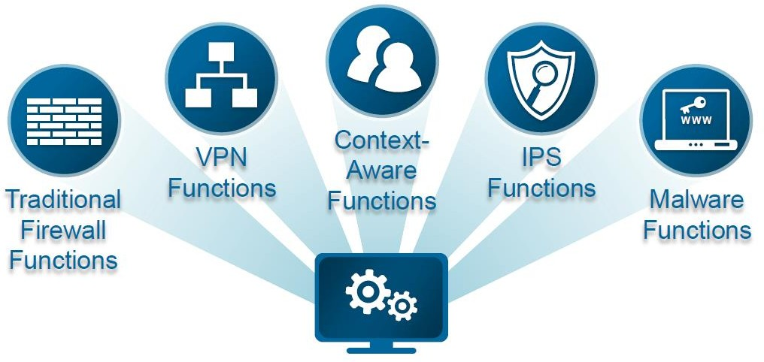
Contrast NGFW, NGIPS
NGFW
Capable of traditional stateful firewall.
Includes AVC.
Supports identity in policy configuration
Provides advanced security protection
NGIPS
Uses pattern matching to detect and drop malicious traffic.
Deployed on the host (HIPS) or network (NIPS)
Utilises contextual information to evaluate threat

Slide 13




Compare NGFW, NGIPS
All require the ability to parse network protocols.
All require security intelligence to keep
up with new threats.
All require adaptation to address the
changing security landscape

Slide 14


Virtual Private Network
B A N K
B A N K
Site to Site
Internet
IPsec VPN
SSL VPN
Headquarters
Remote Access

Slide 15
Security Context (Virtual Firewall)
Four Physical Firewalls
One Physical Firewall
Four Virtual Firewalls
Internet
Internet
Ability to create multiple security contexts within a single security appliance

Slide 16




Failover Capabilities: Active/Standby, Active/Active, and Stateful Failover
Failover: Active/Standby
Failover: Active/Active
Contexts
1
2
1
2
Primary:
Failed Firewall
Secondary:
Active Firewall
Primary:
Failed/Standby
Secondary:
Active/Active
Internet
Internet
Failover protects the network if the primary security appliance goes offline..
Active/standby: Only one unit can be actively processing traffic; the other is hot standby.
Active/Active: Both units can process traffic and serve as backup units.
Stateful failover maintains the operating state during failover.

Slide 17
Transparent Firewall
192.168.1.5
192.168.1.2
Internet
Has the ability to deploy a security appliance in a secure bridging mode
Provides rich L2 through 7 security services as a L2 device

Slide 18
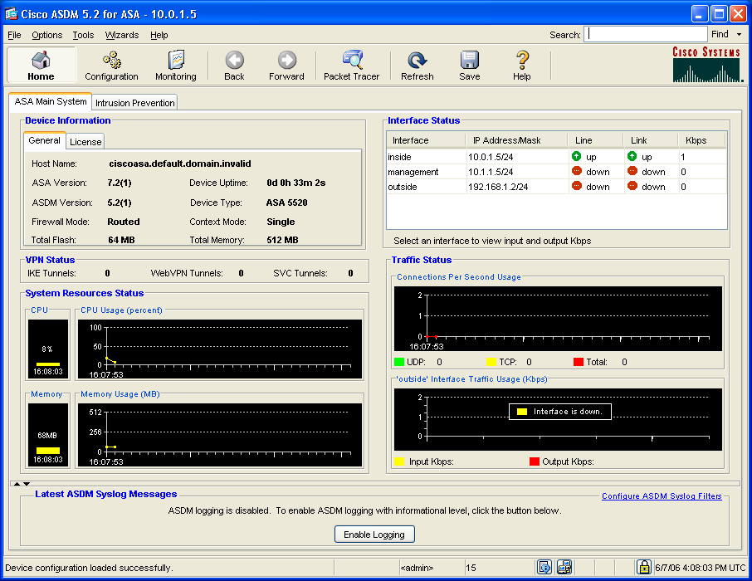
Web-Based Management Solutions
Adaptive
Security
Device
Manager

Slide 19
Summary
A firewall is a system or group of systems that manages access between two or more networks.
Statefull firewall is a device works most effectively
Security devices ASA 5510, 5520 targeting the small and medium enterprises.
The function of security devices can be expanded by the SSMs

Slide 20
Lesson 2 Getting Started with Security Applicances

Slide 21
User Interface

Slide 22

Security Appliance Access Modes
A Cisco security appliance has four main administrative access modes:
Unprivileged
Privileged
Configuration
Monitor
ciscoasa>
ciscoasa#
ciscoasa(config)#
monitor>

Slide 23

Access Privileged Mode
Internet
ciscoasa>
enable [priv_level]
Used to control access to the privileged mode
Enables you to enter other access modes
ciscoasa> enable
password:
ciscoasa#

Slide 24
Access Configuration Mode: configure terminal Command
ciscoasa#
configure terminal
Used to start configuration mode to enter configuration commands from a terminal
ciscoasa#
exit
Used to exit from an access mode
ciscoasa> enable
password:
ciscoasa# configure terminal
ciscoasa(config)# exit
ciscoasa# exit
ciscoasa>

Slide 25
help command
ciscoasa > help ?
enable Turn on privileged commands
exit Exit the current command mode
login Log in as a particular user
logout Exit from current user profile to unprivileged mode
perfmon Change or view performance monitoring options
ping Test connectivity from specified interface to an IP address
quit Exit the current command mode
ciscoasa > help enable
USAGE:
enable [<priv_level>]

Slide 26
File Management

Slide 27
Viewing and Saving Your Configuration
The following commands enable you to view your configuration:
Show running-config
Show startup-config
The following commands enable you to save your configuration:
copy run start
write memory
To save configuration changes:
copy run start
startup-
config
(saved)
running-
config
Configuration
Changes

Slide 28
Clearing Running Configuration
Clear the running configuration:
clear config all
startup-
config
running-
config
(default)
ciscoasa(config)#
clear configure all
Clears the running configuration
ciscoasa(config)# clear config all

Slide 29
Clearing Startup Configuration
Clear the startup configuration:
write erase
startup-
config
(default)
running-
config
ciscoasa#
write erase
Clears the startup configuration
ciscoasa# write erase

Slide 30
Reload the Configuration: reload Command
ciscoasa#
reload [at hh:mm [month day | day month]] [cancel] [in [hh:]mm] [max-hold-time [hh:]mm] [noconfirm] [quick] [reason text] [save-config]
Reboots the security appliance and reloads the configuration
Allows scheduled reboots
ciscoasa# reload
Proceed with reload?[confirm] y
Rebooting...

Slide 31

File System
Release 7.0
and later
Software image
Configuration file
Private data
ASDM image
Backup image*
Backup configuration file*

Slide 32
Displaying Stored Files: System and Configuration
Internet
ASA
disk0:
disk1:
PIX Security Appliance
flash:
ciscoasa#
dir [/all] [/recursive] [all-filesystems] [disk0: | disk1: | flash: | system:]
Display the directory contents
ciscoasa# dir
Directory of disk0:/
8 -rw- 8202240 13:37:33 Jul 28 2006 asa721-k8.bin
1264 -rw- 5539756 13:21:13 Jul 28 2006 asdm-521.bin
62947328 bytes total (49152000 bytes free)

Slide 33
Security Level Example
DMZ Network
GigabitEthernet0/2
Security level 50
Interface name = DMZ
g0/2
Internet
g0/0
g0/1
Outside Network
Inside Network
GigabitEthernet0/0
Security level 0
Interface name = outside
GigabitEthernet0/1
Security level 100
Interface name = inside

Slide 34
Examining Security Appliance Status

Slide 35
show commands
asa1# show run interface
. . .
interface GigabitEthernet0/0
speed 1000
duplex full
nameif outside
security-level 0
ip address 192.168.1.2 255.255.255.0
!
interface GigabitEthernet0/1
speed 1000
duplex full
nameif inside
security-level 100
ip address 10.0.1.1 255.255.255.0 . . .
show run interface
asa1# show interface
Interface GigabitEthernet0/0 "outside", is up, line protocol is up
Detected: Speed 1000 Mbps, Full-duplex
Requested: Auto
MAC address 000b.fcf8.c538, MTU 1500
IP address 192.168.1.2, subnet mask 255.255.255.0
0 packets input, 0 bytes, 0 no buffer
Received 0 broadcasts, 0 runts, 0 giants
0 input errors, 0 CRC, 0 frame, 0 overrun, 0 ignored, 0 abort
0 packets output, 0 bytes, 0 underruns
input queue (curr/max blocks): hardware (0/0) software (0/0)
output queue (curr/max blocks): hardware (0/0) software (0/0)
Received 0 VLAN untagged packets, 0 bytes
Transmitted 0 VLAN untagged packets, 0 bytes
Dropped 0 VLAN untagged packets
show interface

Slide 36
show memory
ciscoasa#
show memory
asa1# show memory
Free memory: 468962336 bytes (87%)
Used memory: 67908576 bytes (13%)
------------- ----------------
Total memory: 536870912 bytes (100%)

Slide 37
show cpu usage
Internet
10.0.1.11
10.0.1.4
ciscoasa#
show cpu usage
asa1# show cpu usage
CPU utilization for 5 seconds = 0%; 1 minute: 0%; 5 minutes: 0%

Slide 38
show version
asa1# show version
Cisco Adaptive Security Appliance Software Version 7.2(1)
Device Manager Version 5.2(1)
Compiled on Wed 31-May-06 14:45 by root
System image file is "disk0:/asa721-k8.bin"
Config file at boot was "startup-config"
ciscoasa up 2 mins 51 secs
Hardware: ASA5520, 512 MB RAM, CPU Pentium 4 Celeron 2000 MHz
Internal ATA Compact Flash, 64MB
BIOS Flash AT49LW080 @ 0xffe00000, 1024KB
. . .

Slide 39
show ip address
172.16.1.0
.1
Internet
192.168.1.0
10.0.1.0
10.1.1.0
.2
.1
.1
asa1# show ip address
System IP Addresses:
Interface Name IP address Subnet mask Method
GigabitEthernet0/0 outside 192.168.1.2 255.255.255.0 CONFIG
GigabitEthernet0/1 inside 10.0.1.1 255.255.255.0 CONFIG
GigabitEthernet0/2 dmz 172.16.1.1 255.255.255.0 CONFIG
Current IP Addresses:
Interface Name IP address Subnet mask Method
GigabitEthernet0/0 outside 192.168.1.2 255.255.255.0 CONFIG
GigabitEthernet0/1 inside 10.0.1.1 255.255.255.0 CONFIG
GigabitEthernet0/2 dmz 172.16.1.1 255.255.255.0 CONFIG

Slide 40
show interface
asa1# show interface
Interface GigabitEthernet0/0 "outside", is up, line protocol is up
Hardware is i82546GB rev03, BW 1000 Mbps
Full-Duplex(Full-duplex), 100 Mbps(100 Mbps)
MAC address 0013.c482.2e4c, MTU 1500
IP address 192.168.1.2, subnet mask 255.255.255.0
8 packets input, 1078 bytes, 0 no buffer
Received 8 broadcasts, 0 runts, 0 giants
0 input errors, 0 CRC, 0 frame, 0 overrun, 0 ignored, 0 abort
0 L2 decode drops
0 packets output, 0 bytes, 0 underruns
0 output errors, 0 collisions
0 late collisions, 0 deferred
input queue (curr/max blocks): hardware (8/0) software (0/0)
output queue (curr/max blocks): hardware (0/0) software (0/0)
Traffic Statistics for "outside":
8 packets input, 934 bytes
0 packets output, 0 bytes
8 packets dropped
1 minute input rate 0 pkts/sec, 0 bytes/sec
1 minute output rate 0 pkts/sec, 0 bytes/sec
1 minute drop rate, 0 pkts/sec
5 minute input rate 0 pkts/sec, 0 bytes/sec
5 minute output rate 0 pkts/sec, 0 bytes/sec
5 minute drop rate, 0 pkts/sec

Slide 41
show nameif
GigabitEthernet0/2
Interface name = dmz
Security level = 50
g0/2
Internet
g0/0
g0/1
GigabitEthernet0/0
Interface name = outside
Security level = 0
GigabitEthernet0/1
Interface name = inside
Security level = 100
asa1# show nameif
Interface Name Security
GigabitEthernet0/0 outside 0
GigabitEthernet0/1 inside 100
GigabitEthernet0/2 dmz 50

Slide 42
show run nat
Internet
10.0.1.11
X.X.X.X
10.0.1.X
NAT
10.0.1.4
ciscoasa#
show run nat
Displays a single host or range of hosts to be translated
asa1# show run nat
nat (inside) 1 10.0.1.0 255.255.255.0 0 0

Slide 43
show run global
Internet
10.0.1.X
10.0.1.11
Mapped Pool
192.168.1.20-192.168.1.254
10.0.1.4
ciscoasa#
show run global
Displays the pool of mapped addresses
asa1# show run global
global (outside) 1 192.168.1.20-192.168.1.254 netmask 255.255.255.0

Slide 44
show xlate
Internet
10.0.1.11
10.0.1.11
192.168.1.20
Outside
mapped pool
Inside
local
Xlate Table
10.0.1.4
192.168.1.20
10.0.1.11
ciscoasa#
show xlate
Displays the contents of the translation slots
asa1# show xlate
1 in use, 1 most used
Global 192.168.1.20 Local 10.0.1.11

Slide 45
show route
172.16.1.0
g0/2
192.168.1.0
10.0.1.0
Internet
.1
g0/0
g0/1
ciscoasa#
show route [interface_name [ip_address [netmask [static]]]]
Displays the contents of the routing table
asa1(config)# show route
S 0.0.0.0 0.0.0.0 [1/0] via 192.168.1.1, outside
C 10.0.1.0 255.255.255.0 is directly connected, inside
C* 127.0.0.0 255.255.0.0 is directly connected, cplane
C 172.16.1.0 255.255.255.0 is directly connected, dmz
C 192.168.1.0 255.255.255.0 is directly connected, outside

Slide 46

ping Command
Internet
10.0.1.11
10.0.1.4
ciscoasa#
ping [if_name] host [data pattern] [repeat count] [size bytes] [timeout seconds] [validate]
Determines whether other devices are visible from the security appliance
asa1# ping 10.0.1.11
Sending 5, 100-byte ICMP Echos to 10.0.1.11, timeout is 2 seconds:
!!!!!
Success rate is 100 percent (5/5), round-trip min/avg/max = 10/12/20 ms

Slide 47
traceroute
Internet
example.com
ciscoasa#
traceroute {destination_ip | hostname} [source source_ip | source-interface] [numeric] [timeout timeout_value] [probe probe_num] [ttl min_ttl max_ttl] [port port_value] [use-icmp]
Determines the route packets will take to their destination
asa1#traceroute 172.26.26.20

Slide 48
Basic Security Appliance Configuration

Slide 49
Basic CLI Commands
hostname
interface
nameif
ip address
security-level
speed
duplex
no shutdown
nat-control
nat
global
route
g0/2
Internet
g0/0
g0/1

Slide 50
Assigning a Hostname to Security Appliance: Changing the CLI Prompt
New York ( asa1)
Server
Boston
(asa2)
Internet
Server
Dallas
(asa3)
Server
ciscoasa(config)#
hostname newname
Changes the hostname in the security appliance CLI prompt
ciscoasa(config)# hostname asa1 asa1(config)#

Slide 51
interface Command and Subcommands
GigabitEthernet0/2
g0/2
Internet
g0/0
g0/1
GigabitEthernet0/0
GigabitEthernet0/1
ciscoasa(config)#
interface {physical_interface[.subinterface] | mapped_name}
Enters configuration mode for the interface you specify
asa1(config)# interface GigabitEthernet0/0
asa1(config-if)#

Slide 52
Assign an Interface Name: nameif Subcommand
GigabitEthernet0/2
Interface name = dmz
g0/2
Internet
g0/0
g0/1
GigabitEthernet0/0
Interface name = outside
GigabitEthernet0/1
Interface name = inside
ciscoasa(config-if)#
nameif if_name
Assigns a name to an interface on the security appliance.
asa1(config)# interface GigabitEthernet0/0
asa1(config-if)# nameif outside

Slide 53
Assign Interface IP Address: ip address Subcommand
g0/2
Internet
g0/0
g0/1
GigabitEthernet0/0
Interface name = outside
IP address = 192.168.1.2
ciscoasa(config-if)#
ip address ip_address [mask] [standby ip_address]
Assigns an IP address to each interface
asa1(config)# interface GigabitEthernet0/0
asa1(config-if)# nameif outside
asa1(config-if)# ip address 192.168.1.2 255.255.255.0

Slide 54
DHCP-Assigned Address
DHCP
Assigned
Internet
g0/0
GigabitEthernet0/0
Interface name = outside
IP address = dhcp
ciscoasa(config-if)#
ip address dhcp [setroute]
Enables the DHCP client feature on the outside interface
asa1(config)# interface GigabitEthernet0/0
asa1(config-if)# nameif outside
asa1(config-if)# ip address dhcp

Slide 55
Assign a Security Level: security-level Subcommands
g0/2
Internet
g0/0
g0/1
GigabitEthernet0/0
Interface name = outside
IP address = 192.168.1.2
Security level = 0
ciscoasa(config-if)#
security-level number
Assigns a security level to the interface
asa1(config)# interface GigabitEthernet0/0
asa1(config-if)# nameif outside
asa1(config-if)# ip address 192.168.1.2
asa1(config-if)# security-level 0

Slide 56
Interfaces with Same Security Level: same-security-traffic Command
DMZ Network
GigabitEthernet0/2
Security level 100
Interface name = dmz
g0/2
Internet
g0/0
g0/1
Inside Network
GigabitEthernet0/1
Security level 100
Interface name = inside
ciscoasa(config)#
same-security-traffic permit {inter-interface | intra-interface}
Enables communication between interfaces with the same security level or allows traffic to enter and exit the same interface
asa1(config)# same-security-traffic permit inter-interface

Slide 57
Assign an Interface Speed and Duplex: speed and duplex SubCommands
GigabitEthernet0/0
Speed =1000
Duplex = full
g0/2
Internet
g0/0
g0/1
ciscoasa(config-if)#
speed {10 | 100 | 1000 | auto | nonegotiate}
duplex {auto | full | half}
Enable the interface speed and duplex
asa1(config)# interface GigabitEthernet0/0
asa1(config-if)# nameif outside
asa1(config-if)# ip address 192.168.1.2
asa1(config-if)# security-level 0
asa1(config-if)# speed 1000
asa1(config-if)# duplex full

Slide 58

ASA Management Interface
Management0/0
Management only = no
g0/2
m0/0
Internet
g0/0
g0/1
ciscoasa(config-if)#
management-only
Configures an interface to accept management traffic only
no management-only
Disables management-only mode
asa1(config)# interface management0/0
asa1(config-if)# no management-only
Disables management-only mode (for ASA 5520, 5540 and 5550)

Slide 59
Enabling and Disabling Interfaces: shutdown Subcommand
g0/2
Internet
g0/0
g0/1
GigabitEthernet0/0
Enabled
ciscoasa(config-if)#
shutdown
Disables an interface
no shutdown = enabled
asa1(config)# interface GigabitEthernet0/0
asa1(config-if)# no shutdown
Disables management-only mode (for ASA 5520, 5540 and 5550)

Slide 60
Network Address Translation
NAT
192.168.0.20
10.0.0.11
Internet
10.0.0.11
192.168.10 .11
Outside
Mapped Pool
Inside
Local
Translation Table
10.0.0.4
192.168.0.20
10.0.0.11

Slide 61
Enable NAT Control
NAT
192.168.0.20
10.0.0.11
Internet
10.0.0.11
200.200.200.11
Outside
Mapped Pool
Inside
Local
Translation Table
10.0.0.4
192.168.0.20
10.0.0.11
Enable or disable NAT configuration requirement
asa1(config)# nat-control

Slide 62
nat command
Internet
10.0.1.11
X.X.X.X
10.0.1.11
NAT
10.0.1.4
ciscoasa(config)#
nat (if_name) nat_id address [netmask] [dns]
Enables IP address translation
asa1(config)# nat (inside) 1 0.0.0.0 0.0.0.0

Slide 63
global command
Internet
10.0.1.11
192.168.1.20
10.0.1.11
NAT
ciscoasa(config)#
10.0.1.4
global(if_name) nat_id {mapped_ip[-mapped_ip] [netmask mapped_mask]} | interface
Works with the nat command to assign a registered or public IP address to an internal host when accessing the outside through the firewall, for example, 192.168.0.20-192.168.0.254
asa1(config)# nat (inside) 1 0.0.0.0 0.0.0.0
asa1(config)# global (outside) 1 192.168.1.20-192.168.1.254

Slide 64
Configure a Static Route: route Command
Default Route
Static Route
Internet
10.0.1.102
10.1.1.11
192.168.1.1
ciscoasa(config)#
10.1.1.4
route if_name ip_address netmask gateway_ip [metric]
Defines a static or default route for an interface
asa1(config)# route outside 0.0.0.0 0.0.0.0 192.168.1.1 1
asa1(config)# route inside 10.1.1.0 255.255.255.0 10.0.1.102 1

Slide 65
Host Name-to-IP-Address Mapping: name Command
“bastionhost”
172.16.1.2
172.16.1.0
.2
.1
Internet
10.0.1.0
“insidehost”
10.0.1.11
.1
.11
ciscoasa(config)#
name ip_address name
Configures a list of name-to-IP-address mappings on the security appliance
asa1(config)# names
asa1(config)# name 172.16.1.2 bastionhost
asa1(config)# name 10.0.1.11 insidehost

Slide 66
Configuration Example
172.16.1.0
.1
Internet
192.168.1.0
10.0.1.0
10.1.1.0
.2
.1
.1
GigabitEthernet0/0
Interface name = outside
Security level = 0
IP address = 192.168.1.2
GigabitEthernet0/1
Interface name = inside
Security level = 100
IP address = 10.0.1.1
asa1(config)# write terminal
. . .
interface GigabitEthernet0/0
speed 1000
duplex full
nameif outside
security-level 0
ip address 192.168.1.2 255.255.255.0
interface GigabitEthernet0/1
speed 1000
duplex full
nameif inside
security-level 100
ip address 10.0.1.1 255.255.255.0 . . .

Slide 67
Configuration Example
GigabitEthernet0/2
Interface name = dmz
Security level = 50
IP address = 172.16.1.1
“bastionhost”
172.16.1.2
“insidehost”
10.1.1.11
172.16.1.0
192.168.1.0
.1
10.0.1.0
10.1.1.0
Internet
.2
.1
.1
interface GigabitEthernet0/2
nameif dmz
security-level 50
speed 1000
duplex full
ip address 172.16.1.1 255.255.255.0
passwd 2KFQnbNIdI.2KYOU encrypted
hostname asa1
names
name 172.16.1.2 bastionhost
name 10.1.1.11 insidehost

Slide 68
Configuration Example
“bastionhost”
172.16.1.2
Default Route
172.16.1.0
.2
Static Route
“insidehost”
10.1.1.11
192.168.1.0
.1
10.0.1.0
10.1.1.0
Internet
.1
.2
.1
.102
.1
Mapped Pool
192.168.1.20 - 254
10.0.0.0
nat-control
nat (inside) 1 0.0.0.0 0.0.0.0 0 0
global (outside) 1 192.168.1.20-192.168.1.254
route outside 0.0.0.0 0.0.0.0 192.168.1.1 1
route inside 10.1.1.0 255.255.255.0 10.0.1.102 1

Slide 69
Summary
Four main administrative access modes: unprivileged, privileged, configuration, and monitor.
Two configuration memories in the security appliances: running configuration and startup configuration.
The show running-config displays the current configuration in the RAM on the terminal.
You can use the copy run start or the write memory command to save the current running configuration.
Interfaces with a higher security level can access interfaces with a lower security level, but interfaces with a lower security level cannot access interfaces with a higher security level unless given permission.
The basic commands that are necessary to configure Cisco security appliances are the following: interface, nat, global, and route.
The nat and global commands work together to translate IP addresses.

Slide 70
Lesson 3 Managing the Security Appliance

Slide 71
Managing System Access

Slide 72

Configuring Telnet Access to the Security Appliance Console
Telnet
10.0.0.11
Internet
ciscoasa(config)#
telnet {{hostname | IP_address mask interface_name} | {IPv6_address interface_name} | {timeout number}}
Enables you to specify which hosts can access the security appliance console with Telnet and set the maximum time a console Telnet session can be idle before being logged off by the security appliance
ciscoasa(config)#
passwd password [encrypted]
Sets the password for Telnet access to set the security appliance
asa1(config)# telnet 10.0.0.11 255.255.255.255 inside
asa1(config)# telnet timeout 15
asa1(config)# passwd telnetpass

Slide 73
Viewing and Disabling Telnet
ciscoasa#
show running-config telnet [timeout]
Displays IP addresses permitted to access the security appliance via Telnet
ciscoasa(config)#
clear configure telnet
Removes the Telnet connection and the idle timeout from the configuration
ciscoasa#
who [local_ip]
Enables you to view which IP addresses are currently accessing the security appliance console via Telnet
ciscoasa#
kill telnet_id
Terminates a Telnet session

Slide 74
SSH Connections to the Security Appliance
SSH connections to the security appliance:
Provide secure remote access
Provide strong authentication and encryption
Require RSA key pairs for the security appliance
Require 3DES/AES or DES activation keys
Allow up to five SSH clients to simultaneously access the security appliance console
Use the Telnet password for local authentication

Slide 75
Configuring SSH Access to the Security Appliance Console
ciscoasa(config)#
ciscoasa(config)#
crypto key zeroize {rsa | dsa} [label key-pair-label] [default] [noconfirm]
crypto key generate rsa [usage-keys | general-keys] [label key-pair-label] [modulus size] [noconfirm]
Removes any previously generated RSA keys
Generates an RSA key pair
ciscoasa(config)#
ciscoasa(config)#
write memory
ssh {ip_address mask | ipv6_address/prefix} interface
Saves the CA state
Specifies the host or network authorized to initiate an SSH connection
ciscoasa(config)#
ciscoasa(config)#
domain-name name
ssh timeout number
Configures the domain name
Specifies how long a session can be idle before being disconnected

Slide 76

Connecting to the Security Appliance with an SSH Client
username: pix
password: telnetpassword
SSH
Internet
172.26.26.50
asa1(config)# crypto key zeroize rsa
asa1(config)# write memory
asa1(config)# domain-name cisco.com
asa1(config)# crypto key generate rsa modulus 1024
asa1(config)# write memory
asa1(config)# ssh 172.26.26.50 255.255.255.255 outside
asa1(config)# ssh timeout 30

Slide 77
Managing Configurations

Slide 78
Viewing Directory Contents
dir
10.0.0.11
Internet
192.168.0.0
10.0.0.3
ciscoasa#
dir [/all] [/recursive] [all-filesystems | [disk0: | disk1: | flash: | system:] path]
Displays the directory contents
asa1# dir
Directory of disk0:/
4346 -rw- 8202240 15:01:10 Oct 19 2006 asa721-k8.bin
6349 -rw- 5539756 15:30:39 Oct 19 2006 asdm521.bin
7705 -rw- 3334 07:03:57 Oct 22 2006 old_running.cfg
62947328 bytes total (29495296 bytes free)
You can use the pwd command to display the current working directory.

Slide 79
Copying Files
copy
10.0.0.11
Internet
192.168.0.0
10.0.0.3
ciscoasa#
copy [/noconfirm | /pcap] {url | running-config | startup-config} {running-config | startup-config | url}
Copies a file from one location to another
asa1# copy disk0:MYCONTEXT.cfg startup-config
Copies the file MYCONTEXT.cfg from disk0 to the startup configuration

Slide 80
Downloading and Backing Up Configuration Files Example
10.0.0.11
Internet
192.168.0.0
config
10.0.0.3
FTP server
ciscoasa#
copy ftp: startup-config
Copies the configuration file from an FTP server
ciscoasa#
copy running-config ftp:
Copies the configuration file to an FTP server

Slide 81
Summary
SSH provides secure remote management of the security appliance.
TFTP is used to upgrade the software image on security appliances.
You can enable Telnet to the security appliance on all interfaces.
.

Slide 82
Lesson 4 Access Control List

Slide 83
Security Appliance ACL Configuration
Internet
Outside
Inside
ACL for
Inbound Access
ACL for
Outbound Access
No ACL
- Outbound permitted by default
- Inbound denied by default
Security appliance configuration philosophy is interface-based.
Interface ACL permits and denies the initial incoming and outgoing packets on that interface.
An ACL must describe only the initial packet of the application; return traffic does not need to be described.
If no ACL is attached to an interface:
The outbound packet is permitted by default.
The inbound packet is denied by default.

Slide 84
Inbound Traffic to DMZ Web Server
DMZ
Public Web
Server
Inbound
X
Inside
Internet
192.168.1.0
.1
.2
10.0.1.0
Outside
There is no ACL, so by default, inbound access is denied. To permit inbound traffic, complete the following steps:
Configure a static translation for the web server address
Configure an inbound ACL
Apply the ACL to the outside interface

Slide 85
Create a Static Translation for Web Server
DMZ
172.16.1.2
Public Web
Server
192.168.1.9
Inside
192.168.1.0
Internet
.1
.2
10.0.1.0
Outside
asa1(config)# static (DMZ,outside) 192.168.1.9 172.16.1.2 0 0
Maps an inside private address to an outside public address

Slide 86
access-list
Permit
Inbound
HTTP
DMZ
172.16.1.2
Public Web Server
192.168.1.9
Inside
Internet
192.168.1.0
.1
.2
10.0.1.0
Outside
ciscoasa(config)#
access-list id [line line-number] [extended] {deny | permit} {protocol | object-group protocol_obj_grp_id}{host sip | sip smask | interface ifc_name | object-group network_obj_grp_id | any} [operator port [port] | object-group service_obj_grp_id] {host dip | dip dmask | interface ifc_name | object-group network_obj_grp_id | any} [operator port [port] | object-group service_obj_grp_id | object-group icmp_type_obj_group_id] [log [[level] [interval secs] | disable | default]] [inactive | time-range time_range_name]
asa1(config)# access-list ACLOUT permit tcp any host 192.168.1.9 eq www
Permits outside HTTP traffic to access the public web server

Slide 87
access-group
Apply ACL
to interface
DMZ
Public Web
Server
Inside
Internet
192.168.1.0
.1
.2
10.0.1.0
Outside
ciscoasa(config)#
access-group access-list {in | out} interface interface_name [per-user-override]
Applies an ACL to an interface
asa1(config)# access-group ACLOUT in interface outside

Slide 88
show access-list Command
ICMPDMZ
ACLOUT
ACLIN
Internet
192.168.1.0
192.168.6.10
asa1(config)# show access-list
access-list cached ACL log flows: total 0, denied 0 (deny-flow-max 4096)
alert-interval 300
access-list ACLOUT; 4 elements
access-list ACLOUT line 1 extended permit tcp 192.168.6.0 255.255.255.0 host 192.168.1.11 eq www (hitcnt=4)0x984ebd70
access-list ACLOUT line 2 extended permit tcp host 192.168.6.10 host 192.168.1.11 eq ftp (hitcnt=1) 0x53490ecd
access-list ACLOUT line 3 extended permit tcp any host 192.168.1.9 eq www (hitcnt=8) 0x83af39ca
access-list ACLOUT line 4 extended deny ip any any (hitcnt=4) 0x2ca30385
access-list ICMPDMZ; 1 elements
access-list ICMPDMZ line 1 extended permit icmp host bastionhost any echo-reply

Slide 89
clear access-list counters
Web Server
172.16.1.2
192.168.6.10
192.168.1.9
ACLIN
Internet
ACLOUT
asa1(config)# clear access-list ACLOUT counters
asa1(config)# show access-list
access-list cached ACL log flows: total 0, denied 0 (deny-flow-max 4096)
alert-interval 300
access-list ACLOUT; 4 elements
access-list ACLOUT line 1 extended permit tcp 192.168.6.0 255.255.255.0 host 192.168.1.11 eq www (hitcnt=0) 0x984ebd70
access-list ACLOUT line 2 extended permit tcp host 192.168.6.10 host 192.168.1.11 eq ftp (hitcnt=0) 0x53490ecd
access-list ACLOUT line 3 extended permit tcp any host 192.168.1.9 eq www (hitcnt=0) 0x83af39ca
access-list ACLOUT line 4 extended deny ip any any (hitcnt=0) 0x2ca30385

Slide 90
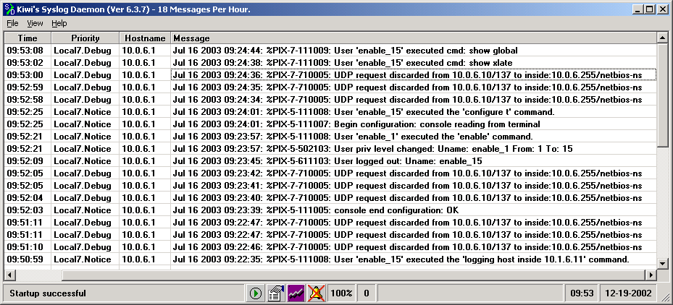
ACL Logging
Internet
ACL Syslog
Messages
Syslog
Server
ciscoasa(config)#
access-list id [line line-number] [extended] {deny | permit} {protocol | object-group protocol_obj_grp_id}{host sip | sip smask | interface ifc_name | object-group network_obj_grp_id | any} [operator port [port] | object-group service_obj_grp_id] {host dip | dip dmask | interface ifc_name | object-group network_obj_grp_id | any} [operator port [port] | object-group service_obj_grp_id | object-group icmp_type_obj_group_id] [log [[level] [interval secs] | disable | default]] [inactive | time-range time_range_name]
asa1(config)# access-list OUTSIDE-ACL permit icmp any host 192.168.1.11 log 7 interval 600
Enables the logging option for inbound ICMP to 192.168.1.11

Slide 91
ACL Comments
ciscoasa(config)#
access-list id [line line-number] remark text
Inserts ACL comment
asa1(config)# access-list ACLOUT line 2 remark WebMailA access-list
asa1(config)# show access-list
access-list cached ACL log flows: total 0, denied 0 (deny-flow-max 4096) alert-interval 300
access-list ACLOUT; 6 elements
access-list ACLOUT line 1 extended permit tcp any host 192.168.1.7 eq www (hitcnt=0) 0x3df6ed1e
access-list ACLOUT line 2 remark WebMailA access-list
access-list ACLOUT line 3 extended permit tcp any host 192.168.1.8 eq www (hitcnt=0) 0xd5383eba
access-list ACLOUT line 4 extended permit tcp any host 192.168.1.9 eq www (hitcnt=0)0x2c4288ad
access-list ACLOUT line 5 extended permit tcp any host 192.168.1.10 eq www (hitcnt=0) 0xb70c935b
access-list ACLOUT line 6 extended permit tcp any host 192.168.1.11 eq www (hitcnt=0) 0x8b43382e
former line 2

Slide 92
Inbound HTTP Access Solution
DMZ
172.16.1.2
Public Web
Server
Inbound
192.168.1.9
Inside
Internet
192.168.1.0
.1
.2
10.0.1.0
Outside
asa1(config)# static (DMZ,outside) 192.168.1.9 172.16.1.2 0 0
asa1(config)# access-list ACLOUT permit tcp any host 192.168.1.9 eq www
asa1(config)# access-group ACLOUT in interface outside
Permits outside HTTP traffic to access the public web server

Slide 93
icmp Command
Internet
Outside
Inside
ICMP Echo
ICMP Unreachable
X
ciscoasa(config)#
icmp {permit | deny} {host sip | sip smask | any} [icmp-type] if_name
Enables or disables pinging to an interface
asa1(config)# icmp permit any echo-reply outside
asa1(config)# icmp permit any unreachable outside
Permits all unreachable messages at the outside interface and denies all ping requests at the outside interface

Slide 94
Summary
ACLs enable you to determine which systems can establish connections through your security appliance.
With ICMP ACLs, you can disable pinging to a security appliance interface so that your security appliance cannot be detected on your network.
.

Slide 95
Lesson 5 Adaptive Security Device Manager

Slide 96
ASDM Overview and Operating Requirements

Slide 97
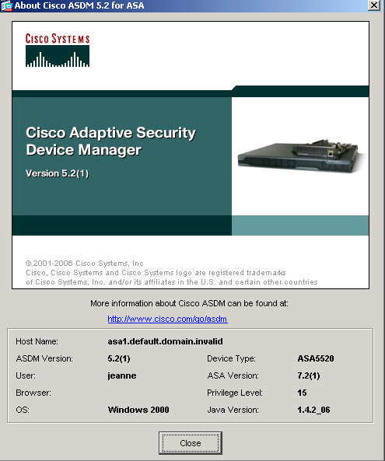
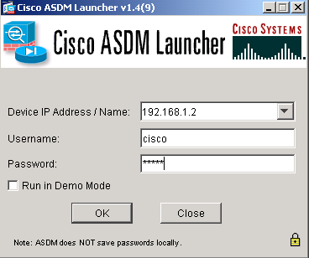
What Is ASDM?
Internet
SSL Secure Tunnel
ASDM is a browser-based configuration tool designed to help configure and monitor your security appliance.

Slide 98
ASDM Browser Requirements
To access ASDM from a browser, the following requirements must be met:
JavaScript and Java must be enabled on the computer where the browser resides.
SSL must be enabled in the browser.
Popup blockers may prevent ASDM from starting.

Slide 99
Configure the Security Appliance to Use ASDM
Before you can use ASDM, you need to enter the following information on the security appliance via a console terminal:
Time
Inside IP address
Inside network mask
Host name
Domain name
Enable the HTTP server on the security appliance
IP addresses of hosts authorized to access HTTP server
If more than one ASDM image is stored in the flash memory of your security appliance, also specify the ASDM image to be used.

